Slide 1
Building dataset from raw data Filip Krasniqi, Jocelyne Elias and Jérémie Leguay
June 19, 2019

Slide 2
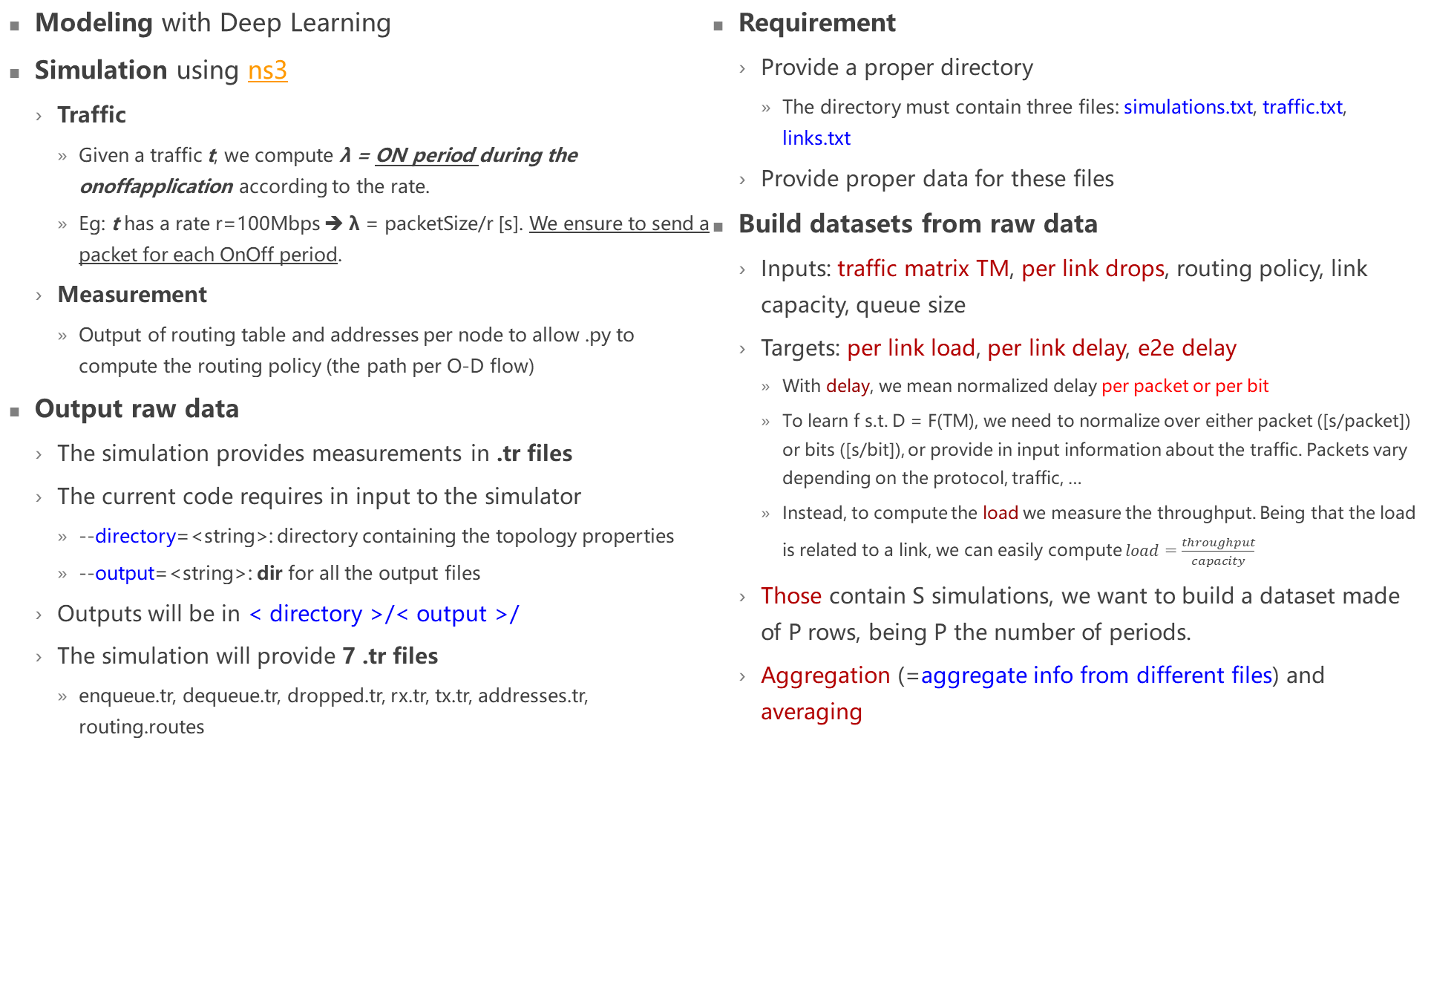
Summary (19/06) + updates
Modeling with Deep Learning
Simulation using ns3
Traffic
Given a traffic t, we compute λ = ON period during the onoffapplication according to the rate.
Eg: t has a rate r=100Mbps ➔ λ = packetSize/r [s]. We ensure to send a packet for each OnOff period.
Measurement
Output of routing table and addresses per node to allow .py to compute the routing policy (the path per O-D flow)
Output raw data
The simulation provides measurements in .tr files
The current code requires in input to the simulator
--directory=<string>: directory containing the topology properties
--output=<string>: dir for all the output files
Outputs will be in < directory >/< output >/
The simulation will provide 7 .tr files
enqueue.tr, dequeue.tr, dropped.tr, rx.tr, tx.tr, addresses.tr, routing.routes
Requirement
Provide a proper directory
The directory must contain three files: simulations.txt, traffic.txt, links.txt
Provide proper data for these files
Build datasets from raw data
Inputs: traffic matrix TM, per link drops, routing policy, link capacity, queue size
Targets: per link load, per link delay, e2e delay
With delay, we mean normalized delay per packet or per bit
To learn f s.t. D = F(TM), we need to normalize over either packet ([s/packet]) or bits ([s/bit]), or provide in input information about the traffic. Packets vary depending on the protocol, traffic, …
Instead, to compute the load we measure the throughput. Being that the load is related to a link, we can easily compute $load=\frac{throughput}{capacity}$
Those contain S simulations, we want to build a dataset made of P rows, being P the number of periods.
Aggregation (=aggregate info from different files) and averaging

Slide 3
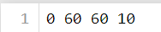
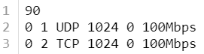
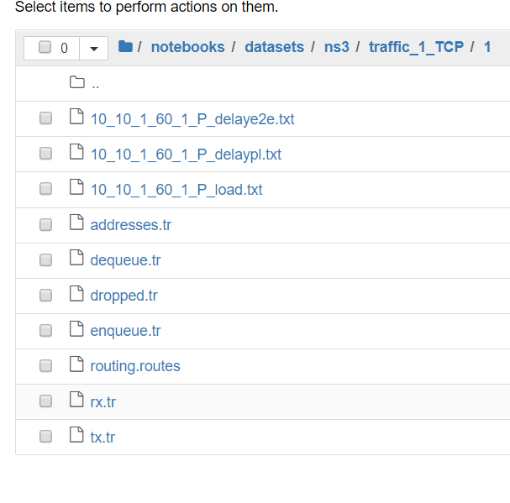
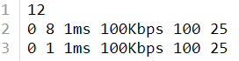
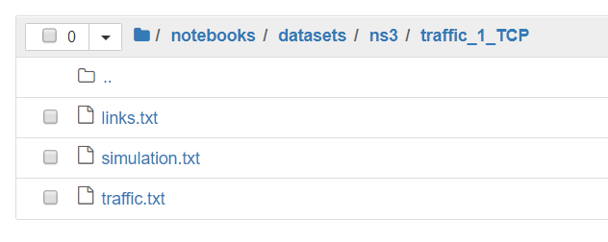
Simulation inputs
Simulations.txt
Single row file containing 4 values, in order: start of application, period length [s], number of periods, number of nodes
Links.txt
L+1 rows.
First row: contains L.
Next L rows: link properties. 6 values per row.
N1 N2 propagation_delay capacity queue1 queue2
N1 N2 define a pair of nodes connected by the link
Queue1: queue at Layer 2
Queue2: parameter to TC layer, so to RED (Random Early Detection)
Example:
Traffic.txt
T+1 rows
First row: contains T
Next T rows: traffic properties. 6 values per row.
O D protocol packet_size n_packets rate
O D define the OD flow
Packet_size (bytes)
N_packets after which the flow stops. If 0, it never stops
Example:
Executing code
Command:
Before execution:
After execution

Slide 4
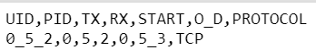
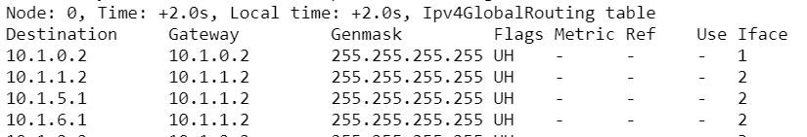
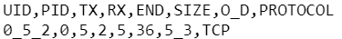
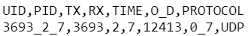
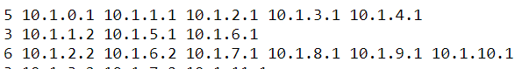
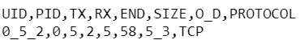
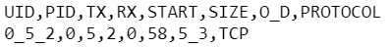
Simulation outputs
Enqueue.tr
A row for each measurement in SendOutgoing or UnicastForward event
Example:
Dequeue.tr
A row for each measurement in UnicastForward or LocalDeliver event
Example:
Dropped.tr
A row for each measurement in RootQueueDiscList/Drop event (TC layer)
Example:
Rx.tr
A row for each measurement in MacRx
Example:
Tx.tr
A row for each measurement in MacTx
Example:
Routing.routes
Output of Ipv4GlobalRoutingHelper::PrintRoutingTableAllAt
Examples:
Addresses.tr
One row for each node. Contains number of addresses and all the addresses for the corresponding node at index I
Examples:
Allows mapping between routing.routes and our way of describing nodes, i.e., with IDs
Details on attributes
PID: packet ID; UID: row global ID in same file = PID_TX_RX
O_D = ORIGIN_DESTINATION
TX = transmitting node, RX = receiving node during O_D flow
START,TIME,END = time of that measurement

Slide 5
Datasets (1/2)
Need to aggregate all of these raw data to build
traffic matrix, per output queue drop, per link load, per link delay, e2e delay: these are multiple measurements for the same simulation
To be considered in a period p, the START/TIME attribute must be in the corresponding p. don’t care about END (it can be on the next period)
Routing policy, link properties: fixed per simulation
Traffic matrix (TM)
Involved files: tx.tr. The traffic is averaged over each period. So, for each period and for each OD, I sum the traffic that is sent and divide it over the period size [s]. No aggregation required
Result: matrix P x N^2, P = #periods, N = #nodes
Dropped (D)
Involved files: dropped.tr. For each period and for each link, I sum the drops.
Result: matrix P x N^2, P = #periods, N = #nodes
Per link delay (PLD)
Involved files: enqueue.tr, dequeue.tr .
Aggregation: I compute the delay (END-START) from the two different files when UID corresponds
Averaging: for each period and for each link, I sum separately the total amount of bits sent and the total delays. Then, I obtain delay[s/bit]
Result: matrix P x N^2, P = #periods, N = #nodes
E2e delay (e2eD)
Involved files: enqueue.tr, dequeue.tr, dropped.tr.
Aggregation: I filter all those rows in enqueue.tr that have a tx = origin, and that have a corresponding instance in dequeue.tr among those that have rx = destination. I don’t consider those that during the path traversal were dropped. Finally, I compute the delay (END-START) from the two different files when UID corresponds
Averaging: for each period and for each OD, same as per link delay
Result: matrix P x N^2, N = #nodes, P = #periods
Load L
Involved files: tx.tr, rx.tr
Aggregation: I filter all those rows in tx.tr that have a corresponding instance in rx.tr.
Averaging: for each period and for each link, same computation as traffic matrix
Result: matrix P x N^2, N = #nodes, P = #periods

Slide 6
Datasets (2/2)
Routing policy R
Involved files: routing.routes, addresses.tr. P=#periods. N=#nodes.
Addresses.tr is used just to assign node IDs instead of addresses
We assume the routing to stay constant during all the simulation.
Reminder: we have not yet control over the routing; we are using ns3 routing policy Ipv4GlobalRoutingHelper::PopulateRoutingTables (). It works with Dijkstra SPF computation (calls BuildGlobalRoutingDatabase and InitializeRoutes() ).
The approach may change when we will define the routing differently. This depends on whether Ipv4GlobalRoutingHelper::PrintRoutingTableAllAt provides the same output regardless of how the routing is defined
We assume we can generate more OD flows for the same OD pair, but the path will always be the same.
Under these two assumptions, each simulation is associated to one row of N^4 values, as we need to identify link and OD flow
The information of OD flow_ij, link (k,l) can be found inside the array at position N^3*i+N^2*j+N*k+l. This value will be 1 if the link (k,l) is traversed by the flow_ij, 0 otherwise
It is possible to combine the two files and obtain this information. Another assumption holds to allow me to compute easily the paths, that is, the routing.routes file will contain either 0.0.0.0 to define a default gateway, or the declaration of the node address. No consideration of subnet masks
Result: vector N^4. I will add this to each row in the corresponding dataset
Link properties: capacity C, propagation delay, queue size Q
Involved files: links.txt .
Refer to“Simulation input”slide
Result
Capacity: vector N^2
Queue size: vector N^2. Represents the queue size at Layer 2
Final datasets (depends on target)
Per link load: TM, R, C, Q, L
Per link delay: TM, D, R, C, Q, PLD
End to end delay: TM, R, C, Q, e2eD
Short term
Deep Learning: learn f s.t. PLD = f(TM)
Fixed network: evaluate generalization capabilities
Do some consideration on how much the features are relevant
Per link drops? Sum of drops?
See how learning is affected when switching among these targets
Next step
Handle different size networks adding in input other features

